Slide 1
Writing Media

Slide 2
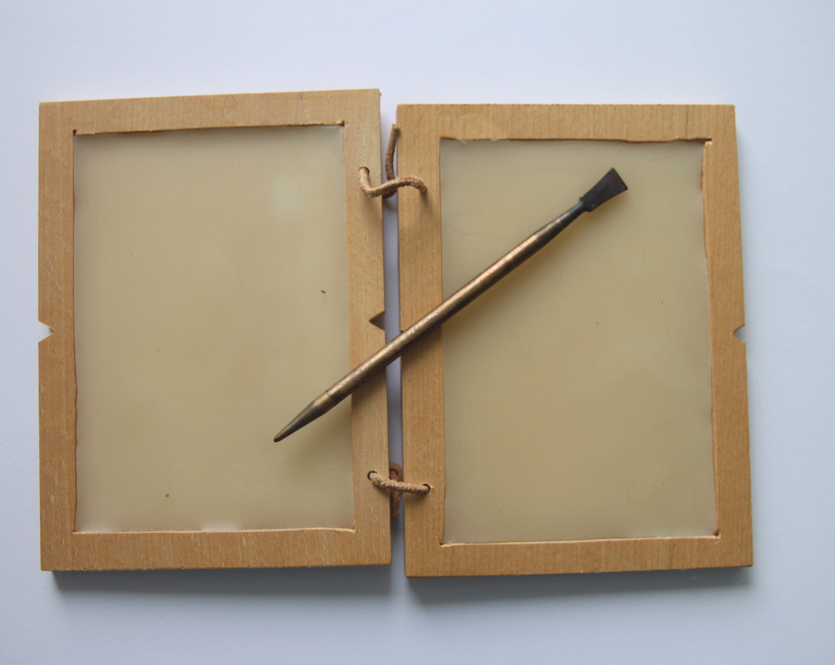
Wax Tablets
Used throughout the ancient world
Generally used for important-but-temporary information
Van der Sluijs, 2012

Slide 3
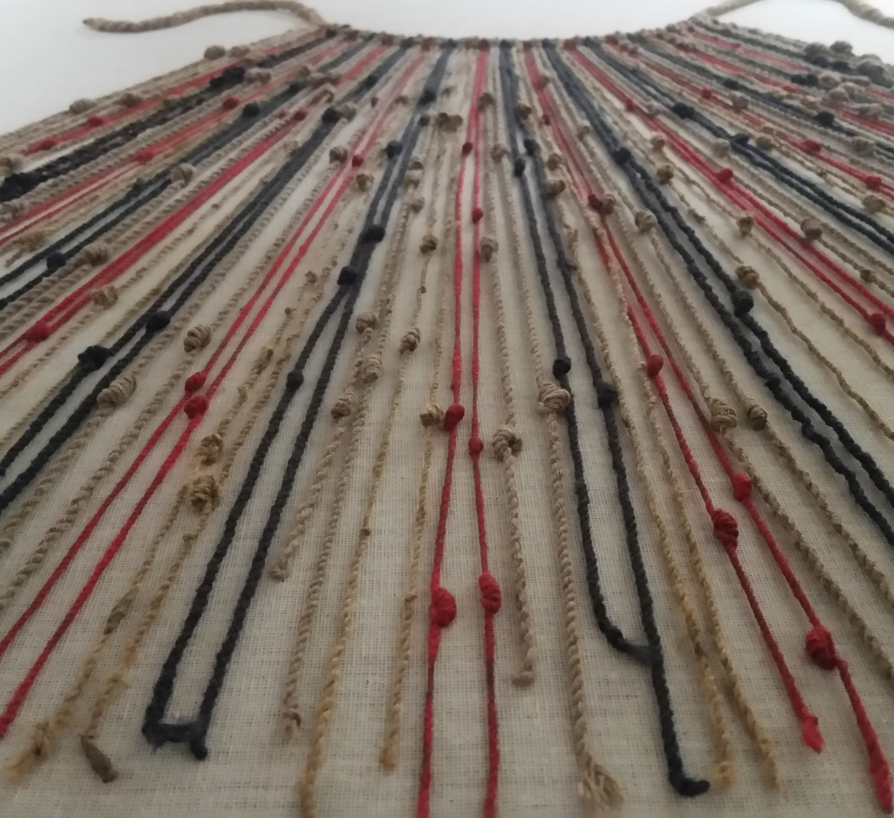
Quipu
Used throughout Mesoamerica
Collection of strings, often of different materials and dyes
Knotted to convey primarily numerical information
Pi3.124, 2018

Slide 4
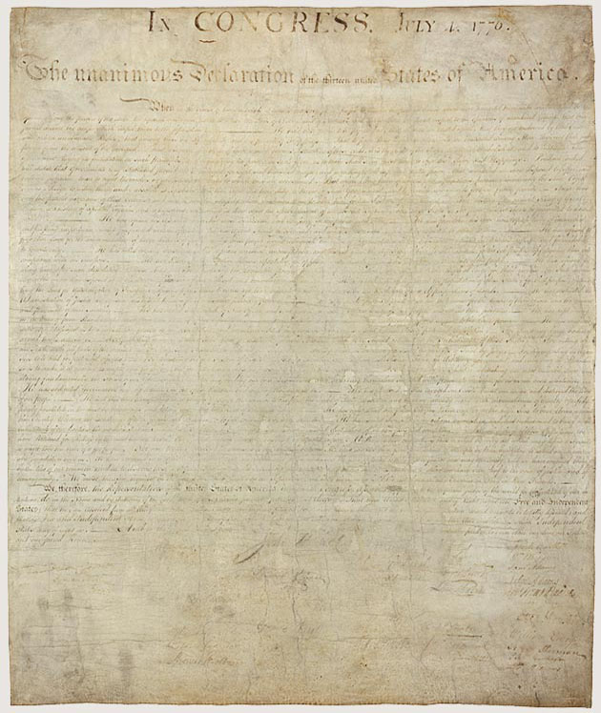
Declaration of Independence
US National Archives, n.d.

Slide 5
When in the Course of human events, it becomes necessary for one people to dissolve the political bands which have connected them with another, and to assume among the powers of the earth, the separate and equal station to which the Laws of Nature and of Nature's God entitle them, a decent respect to the opinions of mankind requires that they should declare the causes which impel them to the separation.
Declaration of Independence
Transcribed version of the first paragraph, so you can read it.
US National Archives, n.d.

Slide 6
References
Pi3.124 (2018, May 28). Quipu in the Museo Machu Picchu, Casa Concha, Cusco [Photograph]. Wikimedia Commons. https://commons.wikimedia.org/wiki/File:Quipo_in_the_Museo_Machu_Picchu,_Casa_Concha,_Cusco.jpg
US National Archives (n.d.) Declaration of Independence [Photograph]. https://www.archives.gov/founding-docs/declaration-transcript
Van der Sluijs, P. (2012, May 12). Writing tablet with wax and stylus. Roman period. The sharp tip was used for writing and the flat end was for wiping it out [Photograph]. Wikimedia Commons. https://en.wikipedia.org/wiki/File:Table_with_was_and_stylus_Roman_times.jpg

